Slide 1
412: Predicting Bankruptcy
By: David Contento, John Macke, Pujan Thakrar, and Mark Vandre

Slide 2

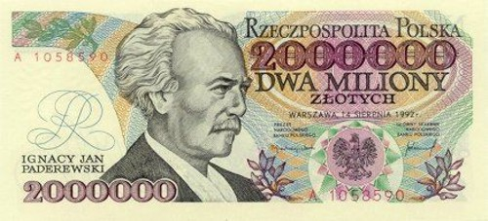
Objective and Data
10503 observation dataset, consists of 64 balance sheet variables
Data is from 2010
Indicator variable signifying bankruptcy
Classification problem
Wanted to fit different models and compare accuracy
Unbalanced dataset

Slide 3
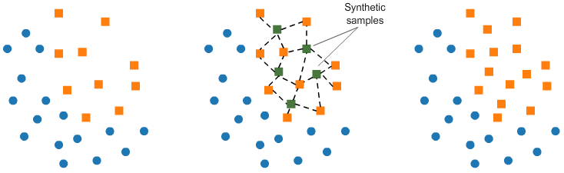
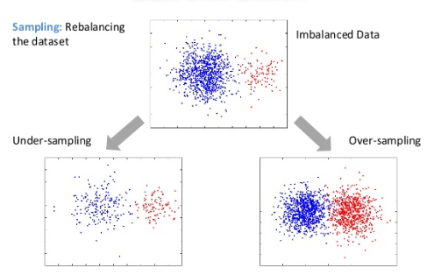
SMOTE: Synthetic Minority Oversampling Technique
Only 5% of observations resulted in bankruptcy
Reduces model prediction performance
Generate synthetic samples (KNN)
Undersample overrepresented class and remove excess
rebalance

Slide 4
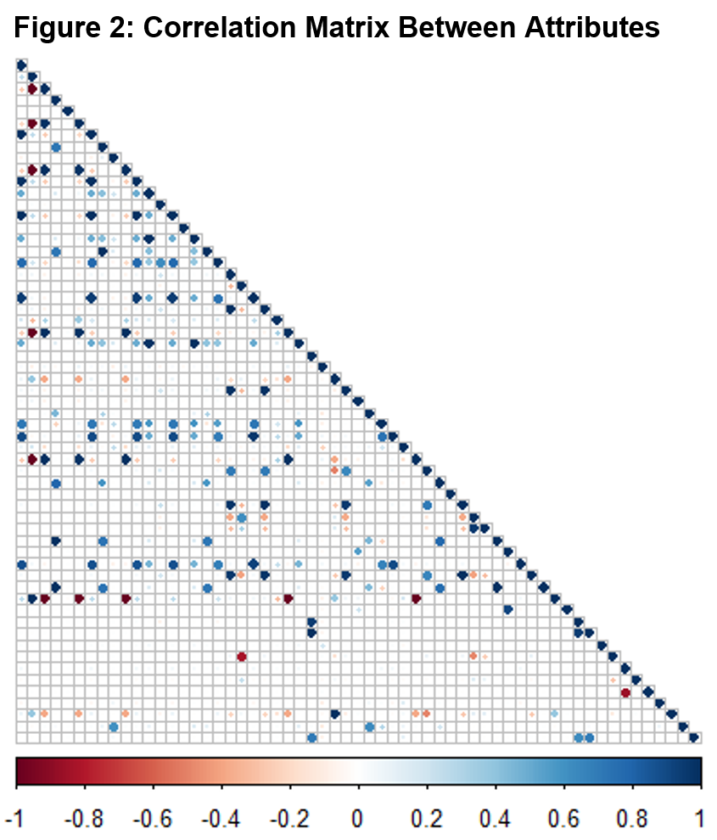
Multicollinearity in Our Dataset
Some variables are combinations of others.
Extreme amount of collinearity
Looked at VIF
Ended up with 38 variables out of 64

Slide 5
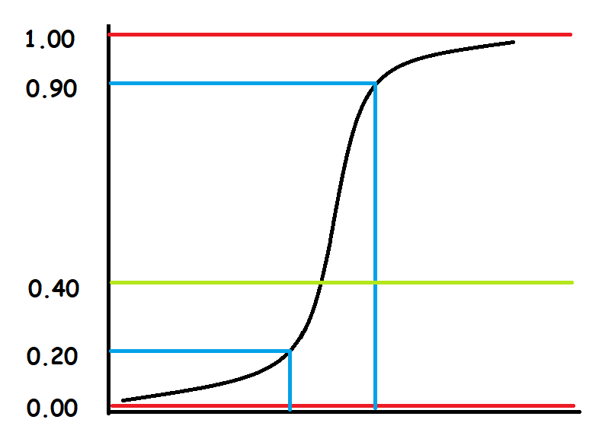
Logistic Regression
← Probability>0.40 is rounded to 1
← Threshold
← Probability<0.40 is rounded to 0
Accuracy: 71% Precision: 58% Recall: 50%

Slide 6
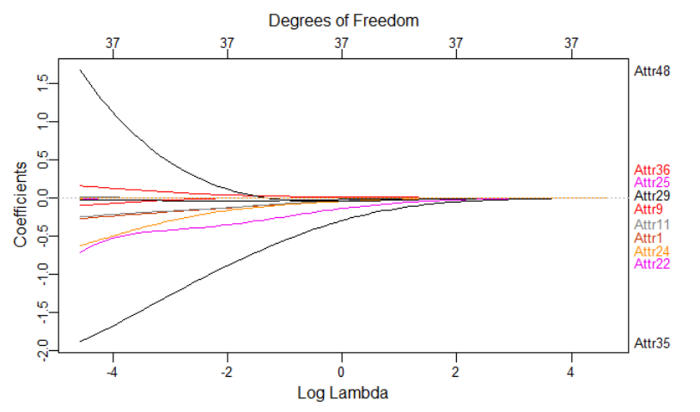
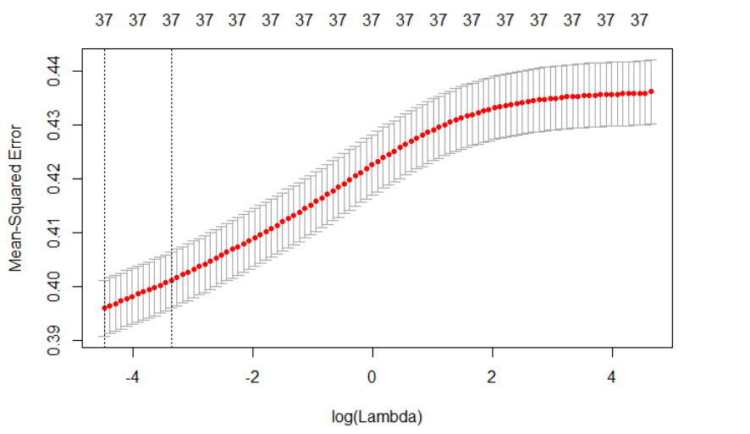
Ridge Regression
Accuracy: 70% Precision: 69% Recall: 28%

Slide 7
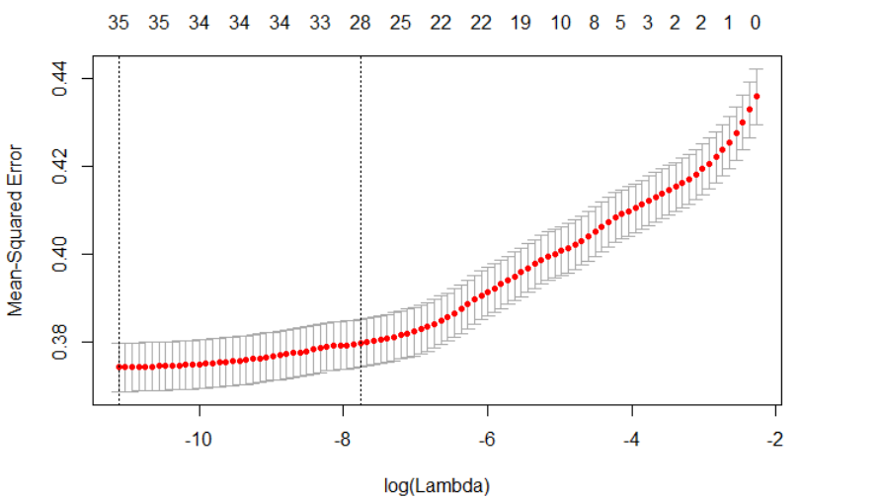
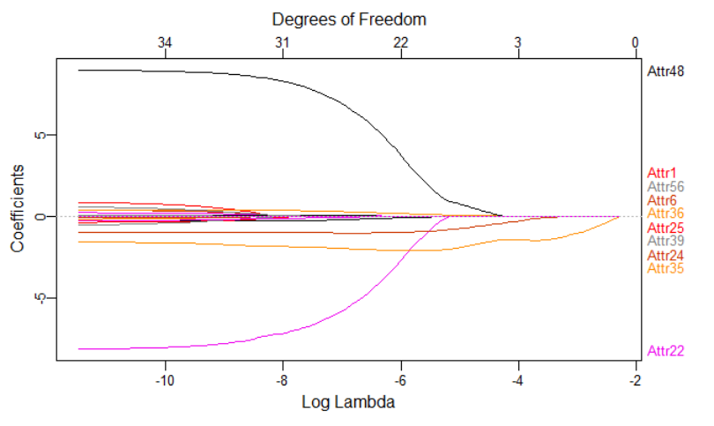
LASSO
Accuracy: 69% Precision: 62% Recall: 19%

Slide 8
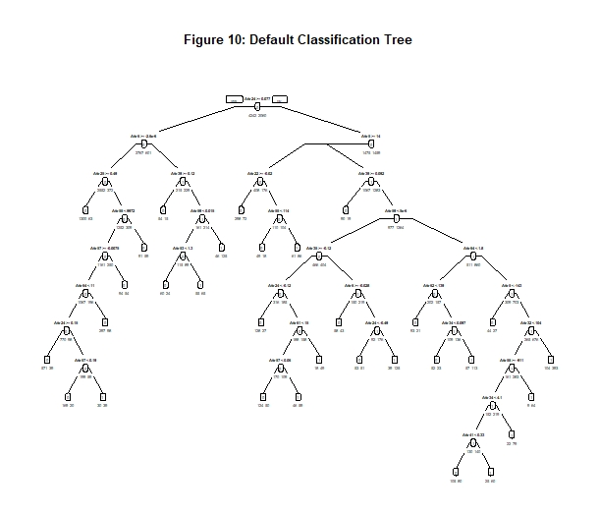
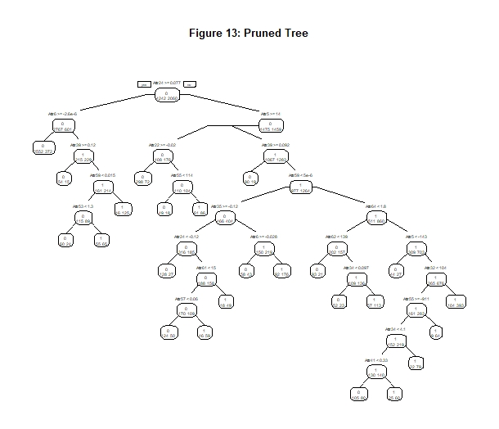
Single Decision Tree vs. Pruned Decision Tree
Cp = 0 Minsplit = 200 nsplit = 31
Cp = 0.001 Minsplit = 200 nsplit = 23
Accuracy: 77% Precision : 69% Recall = 58%
Accuracy: 77% Precision : 69% Recall = 60%

Slide 9
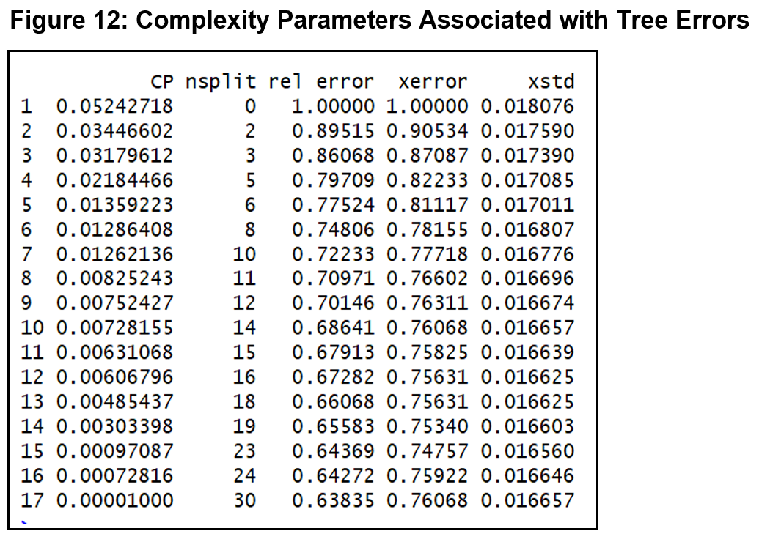
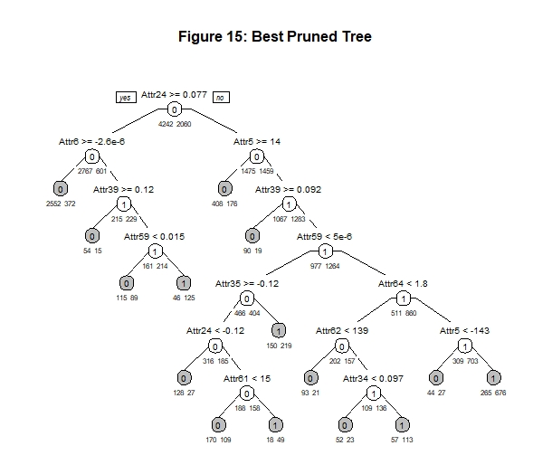
Best Pruned Decision Tree
Cp = 0.0075 nsplit = 12
Xerror = 0.76413 (0.74757+0.016560) → Cp =0.0075
Accuracy: 76% Precision : 68% Recall = 58%

Slide 10
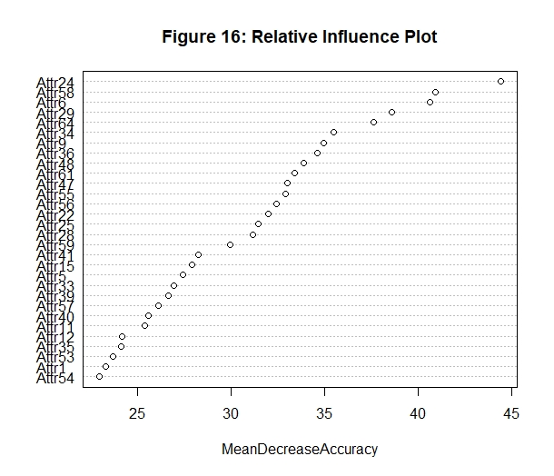

Random Forest
Num Trees = 500
Validation:
Test:
Accuracy: 94% Precision : 96% Recall = 86%
Not transparent → still good for prediction!
Accuracy: 92% Precision : 91% Recall = 82%

Slide 11
Results
Model | Accuracy(%) | Precision(%) | Recall(%)
Logistic Regression | 71 | 58 | 50
Ridge Regression | 70 | 69 | 28
Lasso Regression | 69 | 62 | 19
Decision Tree | 77 | 69 | 58
Pruned Tree | 77 | 69 | 60
Best Pruned Tree | 76 | 68 | 58
Random Forest | 92 | 91 | 82

Slide 12
Results
Model | Accuracy(%) | Precision(%) | Recall(%)
Logistic Regression | 71 | 58 | 50
Ridge Regression | 70 | 69 | 28
Lasso Regression | 69 | 62 | 19
Decision Tree | 77 | 69 | 58
Pruned Tree | 77 | 69 | 60
Best Pruned Tree | 76 | 68 | 58
Random Forest | 92 | 91 | 82
Worst Predictive Model
Lasso

Slide 13
Results
Model | Accuracy(%) | Precision(%) | Recall(%)
Logistic Regression | 71 | 58 | 50
Ridge Regression | 70 | 69 | 28
Lasso Regression | 69 | 62 | 19
Decision Tree | 77 | 69 | 58
Pruned Tree | 77 | 69 | 60
Best Pruned Tree | 76 | 68 | 58
Random Forest | 92 | 91 | 82
Best Predictive Model
Random Forest

Slide 14

Future Work
Additional Machine Learning Algorithms
Support Vector Machine (SVM)
Neural Network
Boosted Trees/XG Boost
Different Settings
United States
Western Europe
China & India
peabodylibrary.org

